Slide 1









IETE Student Forum
Amrita Vishwa Vidyapeetham
Team Name : Team Debuggers
Team Leader Name : Harish Manukonda
Track : Agentic AI

Slide 2


Idea Overview
AI-driven career readiness platform for final-year students and early professionals preparing for technical roles.
End-to-end guidance: skill evaluation → job readiness (structured & measurable)
Initial profiling includes:
Resume analysis
Skill assessment
Market insights
Job / internship recommendations
Role-specific resume tailoring
Three-level adaptive assessment framework:
Medium – MCQs
Hard – MCQs
Difficult – Coding
Clear level-wise cutoffs with personalized feedback based on the exact point of failure
Targeted improvement guidance and AI-powered mock interviews based on user performance
Interview evaluation focuses on communication, confidence, and professional behavior
Designed to help users clearly understand where they are falling short

Slide 3
Opportunity
1. How is our idea different?
Our idea goes beyond generic career portals by offering a structured, multi-level evaluation system that compares candidates with profiles that actually get selected, rather than relying on isolated resume reviews or aptitude tests.
2. How does it solve the problem?
It measures real job readiness through progressive difficulty assessments and level-based feedback, helping users understand not just where they scored low, but why they fall short compared to candidates who get selected especially after repeated rejections without clarity on the exact gaps.
3. USP of the solution
• Competitor-aware, 3-level adaptive assessment with clear cutoffs
• Personalized feedback tied to both performance and comparative gaps
• Unified platform for resume analysis, skills validation, testing, and interview readiness

Slide 4
Breaking the Career Black Box: Digital Twin vs Ghost Competitors
Problem
Candidates satisfy job requirements yet get rejected because hiring operates as a black box, hiding real competition and the actual signals used for selection.
Our Approach
Using the Entity Recognition in Resumes (Kaggle, JSON) dataset, we construct a Digital Twin of the candidate and a Ghost Twin from successful profiles, then compare both to expose the Hidden Wall—the exact gaps blocking selection.
Outcome
Clear explanation of career gaps based on real hiring standards mapped to real hiring benchmarks, along with a Success Probability score and clear, role-specific guidance on what to improve next.
Why This Is Novel
Unlike generic AI mentors, this approach is competitor-aware, showing candidates how close they are to selection instead of giving generic advice.

Slide 5
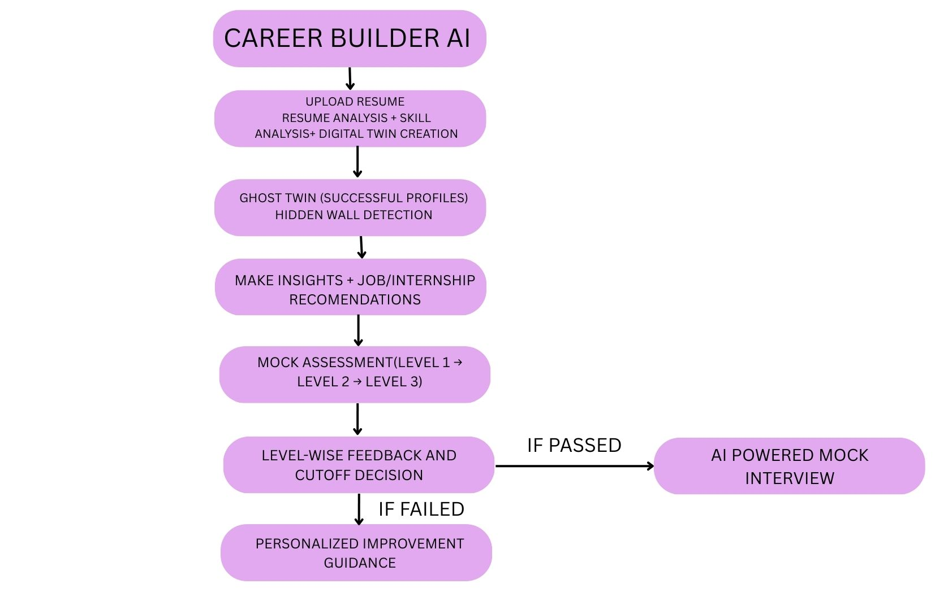
Process flow diagram

Slide 6
Planned Features & System Capabilities
AI-based resume analysis for skill extraction and understanding
Digital Twin based career gap diagnosis using structured resume data
Career goal selection support with role-specific guidance
Market insight integration for relevant job and internship discovery
Resume tailoring assistance aligned to chosen roles
3-level adaptive skill assessment framework with clear cutoffs
Level-based feedback mechanism with targeted improvement suggestions
AI-powered mock interview module for advanced-stage candidates

Slide 7
AI Technologies Planned & In Use
LLM – Qwen-3 (8B) via Ollama
→ Resume analysis, skill evaluation, feedback & interview questions
Agentic AI (Think → Plan → Act)
→ Understand profile, plan tests, guide next steps
Rule-Based Logic
→ Cutoff decisions using simple if-else (clear & explainable)
NLP
→ Resume + answer understanding, personalized guidance
CV + Speech Analysis (Mock Interview)
→ Posture, confidence & communication via camera and microphone
Tech Stack
→ Flask + HTML/CSS/JS
Dataset:
→ Entity Recognition in Resumes (Kaggle) for skill, role, and feature extraction

Slide 8
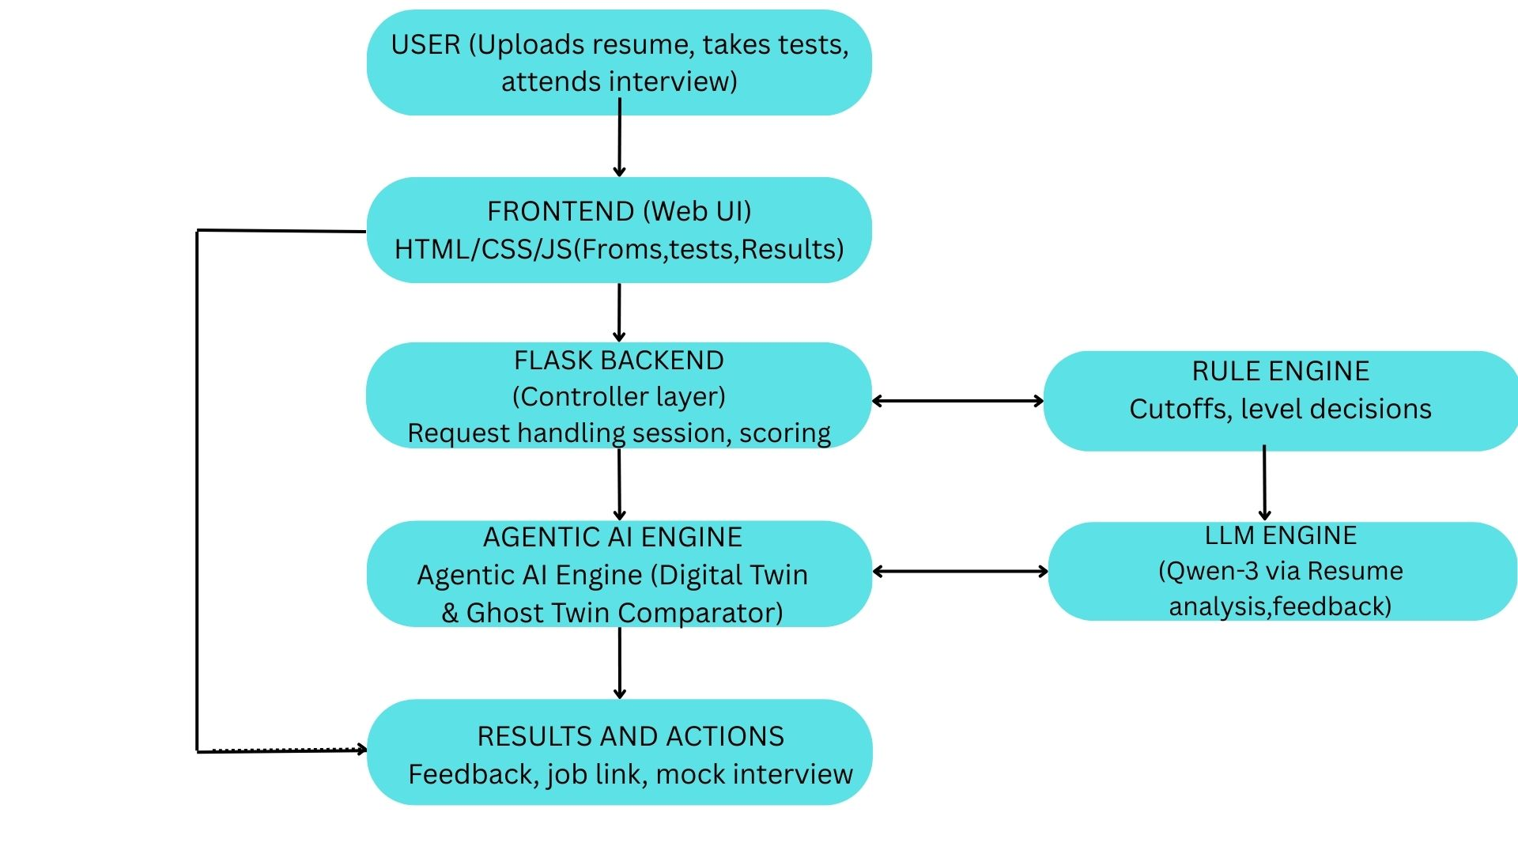
Architecture diagram of the proposed solution

Slide 9
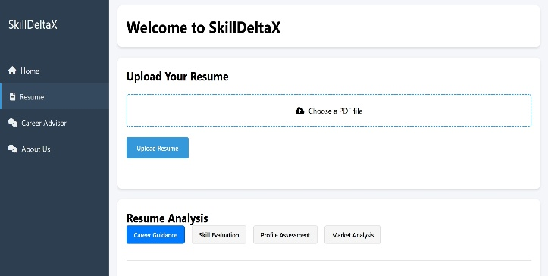
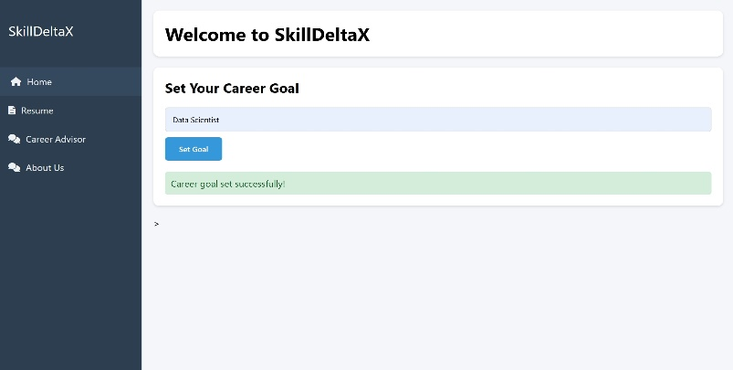
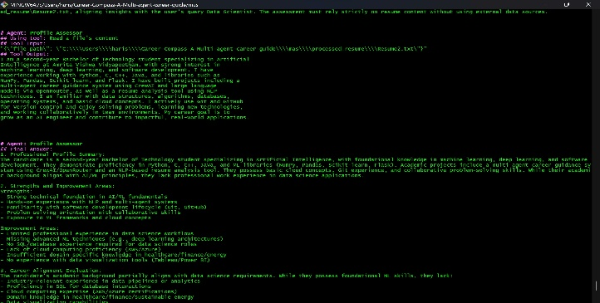
Mock Frames(Partial Implementation)
Enables users to upload their resume and access AI powered resume analysis features.
Displays detailed backend analysis of skills, strengths, gaps and career recommendations generated by the system
Allows users to select and confirm their desired career path for personalized guidance.

Slide 10
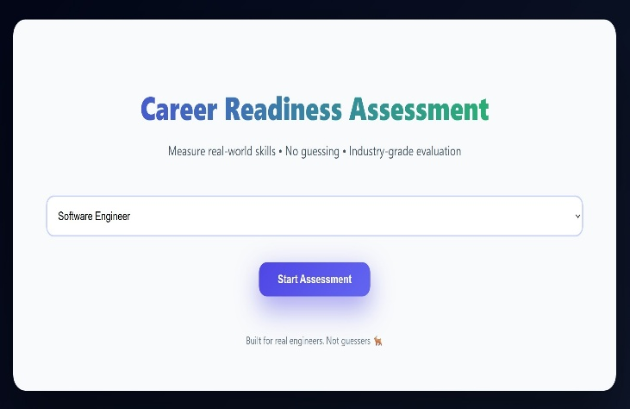
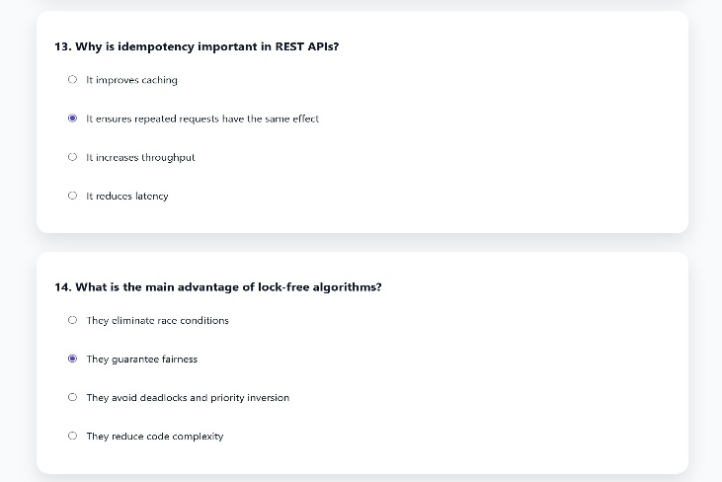
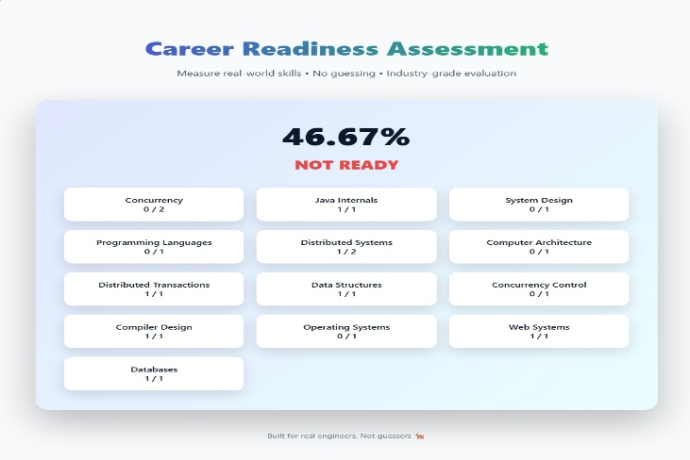
Mock Frames(Partial Implementation)
The landing page of the website, which directs users to the main test page for further interaction.
The MCQ section, where users attempt assessments and tests to evaluate their knowledge.
The results section, where test responses are analyzed and overall career suitability is evaluated.

Slide 11
Thank You!
Team Debuggers

